Slide 1

Where have we been?
Where are we going?
A review

Slide 2
What we will cover
How learning = credit
The importance of being (constructively) critical
Looking ahead to the news days

Slide 3
You’ve come a long way (technically)
Spreadsheets
Datavis
Coding (even if just familiarity)

Slide 4
You’ve come a long way (intellectually)
Computational thinking
Transparency and literate programming
Critical issues in mapping & vis
Data cleaning, e.g. Tidy Data
Equality, diversity and inclusion
Data and power

Slide 5
You can also draw on…
Narrative concepts & structure
Idea generation techniques
Story research
Interview planning
Visual and video storytelling
Writing for social
Writing for the web
Research in Practice: critical issues

Slide 6
Your stories are just the tip of the iceberg

Slide 7
3-5 stories for submission
Other interviews
Other stories + social
News days
Reading & watching
Planning
Story research
Idea brainstorming

Slide 8
The less you do below the surface, the smaller the peak
Criteria 1
Stories for submission
News days
Reading
Criteria 2
Planning
Story research

Slide 9
The portfolio
A collection of journalism using data. Consider:
Interviews
Visualisation/interactivity
Social updates
Audio/video (e.g. two-ways, animated video etc)
Choose your best three stories.
Include other stories in appendices as evidence of planning, development and professionalism

Slide 10
The critical evaluation
✅ What isn’t visible in the stories (e.g. planning)? ✅ Why did you do what you did? ✅ What would you do differently (next time)? ✅ What skills/knowledge do you need to develop?
Show evidence of planning, brainstorming, etc.
Relate decisions and suggestions to literature: best practices/professional practice, ethics (e.g. accuracy, transparency, EDI + accessibility, power), law, etc.

Slide 11
BCU Journalism Style, Sourcing, Ethics and Legal Guide: Everything you need to know about writing tips, sourcing stories, style, ethics and guidelines
Table of contents
Table of contents
News vs features
Story ideas and pitching
General points on structure and style
The headline
‘Second headlines’ and standfirsts
The first paragraph (intro)
Speaking in the first person
The ending
A brief guide to genres and formats
Sourcing
Press release-based stories
Embargoes
Council meeting-based stories
Court- or police-based stories
Social media sources
Lurking: ethical considerations
Critical stories: the ‘right of reply’
Source requests to see stories before publication, or for “copy approval”
Background information: Wikipedia and other sources
Interviewing people
Sources with a ‘right of reply’ who refuse to respond
Unnamed (confidential) sources and requests for anonymity
Off the record/“on background”
Chatham House rules
Anonymous sources (you don’t know their identity)
Vulnerable sources
Sourcing images and other media
Undercover reporting, secret recording and subterfuge
Safety
Covering protests

Slide 12
Legal issues and regulation
You can find a list of legal issues to consider when reporting in this free guide to media law and ethics by our visiting professor Tim Crook. The key ones to look out for are:
Copyright (use of any material which you haven’t created - that can be images, audio, video or passages of text)
Defamation (reporting any information which might cause someone to ‘think badly’ or an organisation or person)
Contempt (reporting on a crime where proceedings are ‘active’)
Data protection (collecting and storing personal information)
Under-18s
Privacy (information about private life, e.g. health, finances)
More details below. If you think that your article raises legal issues (e.g. defamation, contempt) please indicate at the top of the article so that your editor can see it before any story is published. Be as specific as possible about your concern.
Defamation
If anything you publish would cause someone to think badly of a person or organisation, then it is defamatory and you could be sued for libel.
Note that this still applies if you are quoting someone else, e.g.
“Bob Jones said ‘Jim Smith is corrupt’” is just as defamatory as
“We think Jim Smith is corrupt” or indeed
“There are rumours that Jim Smith is corrupt”
If you think that content is defamatory seek the advice of a tutor. Some points to consider:
Do you have proof that it is true? For example, it is defamatory to call someone a murderer, but if they’ve been convicted of murder then you have clear proof. Likewise if someone is accusing someone of unethical behaviour then make sure you have a copy of their proof.
How likely is the person or organisation to sue? If the information has been widely published for some time and no legal action has been taken, then the likelihood of you being sued will be low (but not zero).
Note that public sector organisations cannot sue for libel, but individuals within those organisations can — even if not directly named. Charities and businesses are not public sector organisations and can sue.

Slide 13
Include copyright details
“See Appendix D for copyright details on all images”
Image 1: Sourced from Pexels, free to use, no attribution required https://www.pexels.com/photo/vintage-british-telecom-telephone-cream-28248426/
Image 2: Creative Commons CC BY 2.0. Attribution required https://flickr.com/photos/veisto/3712676990/in/photolist-6E5rwf-5Rsesp-791bYx-pAqNi-a38oJt-ad2brS-aa5SVm-6RpRAT-6ZKfUS-axfcpJ-fnEDP-2EHxm3-hTtiy-ovtUSw-JFPrVs-6WFppv-2DRbgt-sG2dyS-nzJosN-6iHrCM-hmrvMR-54yH2L-9K16HF-bX8JbY-ciQV5h-afKdvG-6WFpN2-ciQVbL-fex2nf-fex69Y-fex3iE-51X8dH-fex1a5-XnP4z1-nzJu4h-nitPHG-fex5gj-oFLXXm-brSAVB-WdnWEi-pArjw-oeFzCM-71tq9a-fex71b-nuQfWJ-ubbhHz-71tq7F-71xpFC-QVVRa-rmmory
Image 3: Generated by DALL-E. See appendix E for prompts.
Image 4: Provided by interviewee. See email below.

Slide 14
Ethics in data journalism: accuracy
The following is the first in a series of extracts from a draft book chapter on ethics in data journalism. This is a work in progress, so if you have examples of ethical dilemmas, best practice, or guidance, I’d be happy to include it with an acknowledgement.
Data journalism ethics: accuracy
Probably the most basic ethical consideration in data journalism is the need to be accurate, and provide proper context to the stories that we tell. That can influence how we analyse the data, report on data stories, or our publication of the data itself.
In late 2012, for example, data journalist Nils Mulvad finally got his hands on veterinary prescriptions data that he had been fighting for for seven years. But he decided not to publish the data when he realised that it was full of errors.
“Publishing it directly would have meant identifying specific doctors for doing bad things which they hadn’t done. So we only used the data to point us to possible bad examples from which to start the journalistic research and verify information.”
Similarly, when Mulvad approached school leaders about data released by the Danish ministry of education, it turned out grades had been miscalculated. Getting a response on data before publishing is a vital step in checking its accuracy, and the more independent the responding party, the better.
US data journalist Dan Nguyen draws a parallel with traditional journalism processes on this:
https://onlinejournalismblog.com/2013/09/13/ethics-in-data-journalism-accuracy/

Slide 15
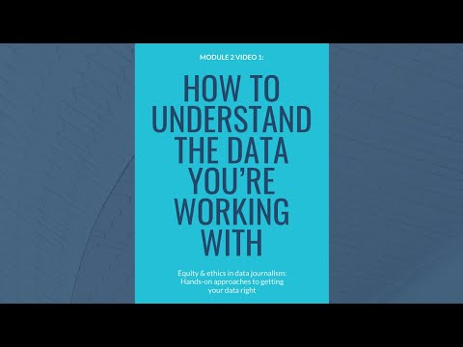
Data ethics playlist: https://www.youtube.com/watch?v=t5ku0MhmBB8&list=PL-ZV9BlgytWiMb0UadHhNfOdsQfxoOq08&index=0

Slide 16
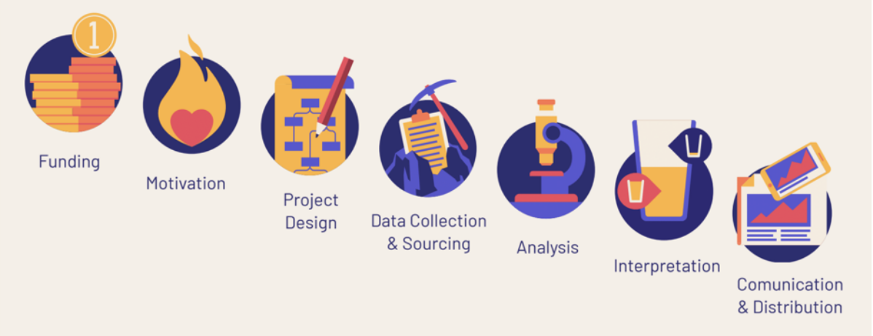
“The worldviews and hidden, implicit biases of people involved are embedded in every single stage of data and evaluation. And each step presents us with the opportunity to increase equity, inclusion, and fairness.”
https://idatassist.com/what-does-your-datas-life-cycle-look-like/

Slide 17
Professionalism & prof. context
The role of:
Deadlines & timeliness
Corresponding with editors, etc.
Consideration of audience
Consideration of style (e.g. colour, fonts)
Newsroom organisation and planning (readings)
Negotiation with colleagues
Legal considerations
Distribution: SEO, SMO, engagement, use of social

Slide 18
Make a ‘treasure map’
With especially large datasets it can be easy to ‘lose your way’ as you explore websites trying to locate the specific data you need, going from one spreadsheet to another in search of more granular detail, or information in a particular category or period.
In those situations it is useful to keep track of where you’ve come from and where you went, in order to retrace your steps later and help others to find the same data. A ‘treasure map’, if you like — or a breadcrumb trail. Here are two examples.

Slide 19
…and of course, AI
What role, if any, did AI play in your production processes? (And if not, why not?)
Provide evidence: prompts and responses in full (including iteration)
What did you read/watch to inform your use of AI? What do you need to explore next?
What worked well — what worked poorly? Why?
Tip: for search try Henk Van Ess’s Prompt Bakery

Slide 20
“Three pivotal components underpin effective prompt engineering:
comprehensive content knowledge,
critical thinking,
and an iterative design approach.”
William Cain 2023

Slide 21
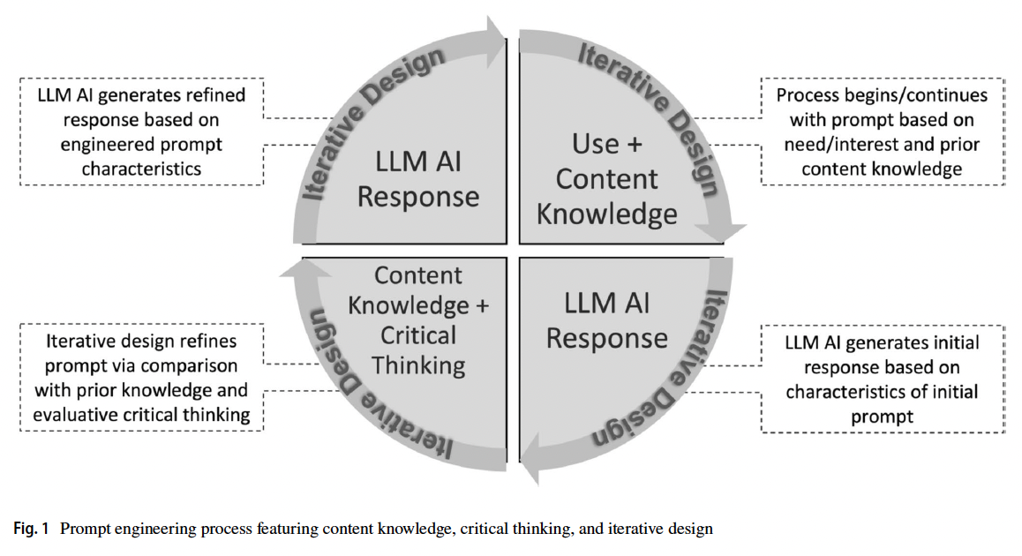
Put it into practice…
Reference: Cain, William. Prompting Change: Exploring Prompt Engineering in Large Language Model AI and Its Potential to Transform Education, TechTrends, October 18 2023, https://link.springer.com/article/10.1007/s11528-023-00896-0

Slide 22
0%
52-8%
62-8%
72%+
GenAI tool use not mentioned
Evaluation includes evidence
Evidence and references
+ critical reflection and experimentation
If you’ve used GenAI tools without saying so, this is considered plagiarism and a zero mark
E.g. “I used ChatGPT to generate ideas around my dataset (see Appendix A)”
E.g. “I used ChatGPT to generate ideas (see Appendix A) using techniques outlined by Marconi (2023)”
E.g. “I added prompts to guard against bias in terms of ethnicity, gender etc. (Heikkilä 2023. See Appendix B)”
Attribute any use of AI
Make it clear what is your work, and what is not
Include evidence to clarify
Identify what you did well — and could do better
Copy and paste the prompt(s) and response(s) in full
Use a different appendix for each example
Reflect on them
Draw on original sources used in lectures
Focus on practical literature — don’t quote facts and stats
Identify next steps
Read about good practice and try those techniques
Don’t settle for the first results: experiment
Reflect on what works and what doesn’t

Slide 23
News days

Slide 24
Key points
Show you’ve learned (through reading, practice, experimentation)
Be constructively critical: it’s not supposed to be perfect
Use the news days to do the above and add professionalism

Slide 25
Directed study
Check data releases and follow the news
Brainstorm ideas for both news days.
Work on at least one story to do:
Background research, including previous data
Datavis practice: template charts/maps
Identify contacts and organise interviews
Communicate your plans on Slack

Slide 26
Further reading
Watch: Health and safety video (25’)
Enrol: Safety & resilience course (120’)
Diversity, Equity and Inclusion in Data Reporting
Look at the examples of previous student work on Moodle
Pick a reading from folder on newsrooms in the news days section on Moodle
Optional: more on AI and machine learning (ML) in the additional materials section on Moodle

Slide 27

Video playlist from the NCTJ course on safety & resilience

Slide 28
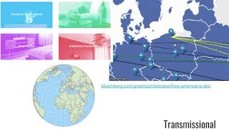
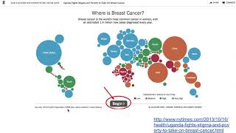
Optional: interactivity

Slide 29
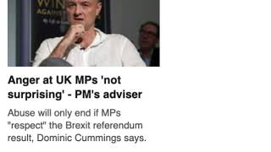
Optional: journalistic writing
https://www.youtube.com/watch?v=hjl35DH53rI&feature=youtu.be

